Slide 1


BOLLIWOOD-BIAS BUSTER
AI-POWERED PLATFORM TO DETECT GENDER STEREOTYPES IN INDIAN FILMS
-Raj Verma

Slide 2
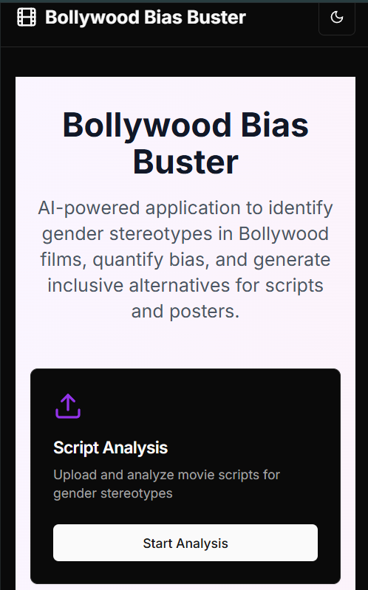
Table Of Content
Problem Statement
Key Functionality
Why this?
Overall Description
Technology Used
Project Snap Shot
Dataset Used
Conclusion

Slide 3

Problem Statement
Gender stereotypes are deeply embedded in Bollywood scripts, visuals & posters.
Women are often portrayed in passive or dependent roles, unlike men (e.g., "occupation gap").
Goal: Automate the detection, quantification, and mitigation of such biases from:
-Scripts & Wikipedia summaries
-Posters
-Trailer transcripts

Slide 4
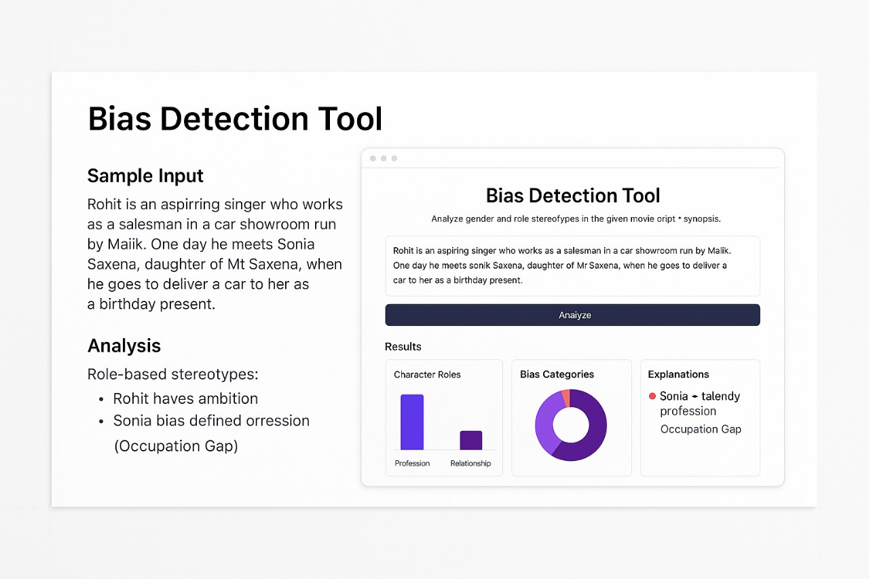
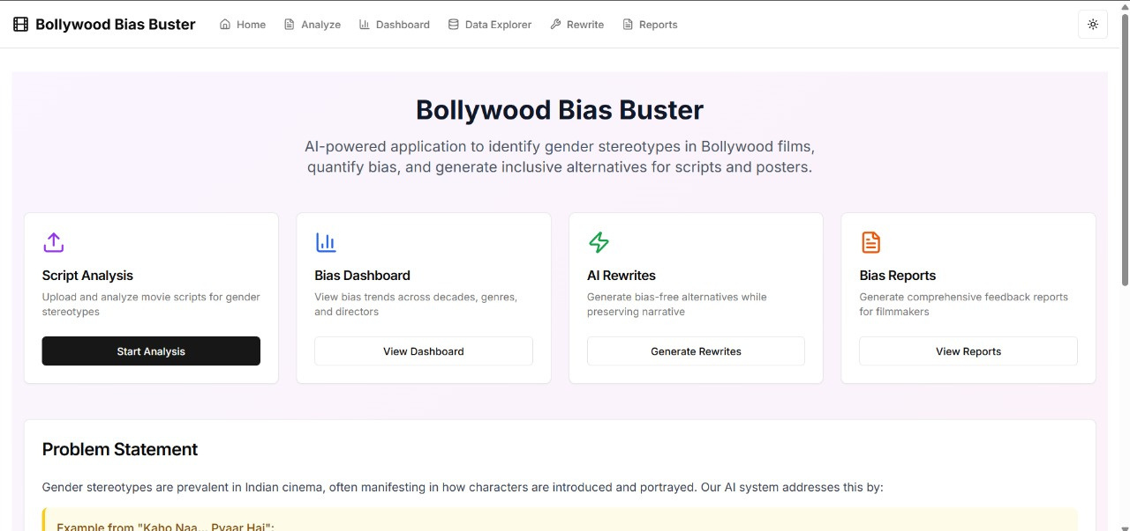
WHAT IS
Bolliwood-Bias Buster
Bollywood Bias Buster is an AI-driven web app that detects and quantifies gender stereotypes in Bollywood scripts, posters, and summaries. It highlights biases, visualizes trends, and suggests inclusive rewrites—helping filmmakers build fairer, bias-free stories.

Slide 5

Technologies Used
Backend (ML & NLP)
Frontend
spaCy, TextBlob, scikit-learn – NLP & stereotype tagging
pandas, numpy, matplotlib, plotly – data manipulation & viz
LLMs (e.g., OpenAI API) – Rewriting suggestions
Next.js + TypeScript
TailwindCSS + ShadCN + Radix UI
OpenAI SDK + Lucide icons for sleek UI

Slide 6
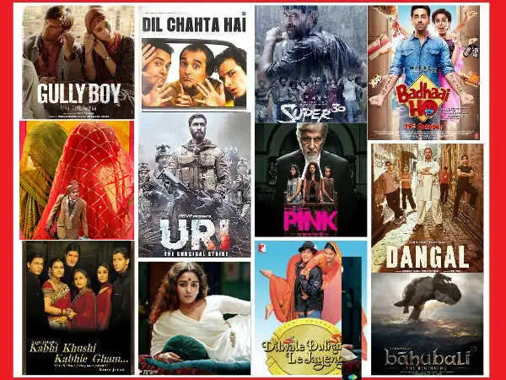
Dataset Used
Bollywood Data (1970–2017) from BollywoodData GitHub
Includes:
Movie scripts, Wikipedia synopses
Poster images & trailer transcripts
Metadata like release year, cast, genre
Custom cleaning pipeline created to extract character roles, gender, and text segments.

Slide 7

Key Functionalities
01.
02.
03.
Solution
Solution
Solution
Gender and role-based stereotype detection
Classifies into: occupation gap, agency gap, appearance focus
Trend visualizations: decade-wise, character-wise
LLM-based “bias-free” text rewriting
Auto-generated Bias Feedback Report (PDF/HTML)

Slide 8
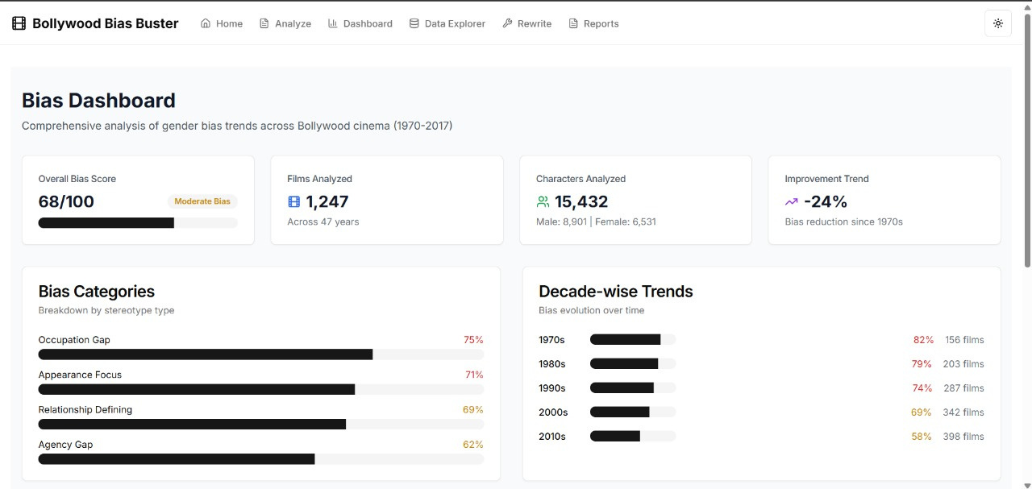
Overall Description
Designed the full AI pipeline – From data cleaning to deployment
Implemented stereotype detection using spaCy, TextBlob, and ML models
Built bias quantification engine to analyze trends across time, gender, and films
Integrated OpenAI LLM for bias-free text rewriting
Developed UI using Next.js, TailwindCSS, and Radix UI
Created PDF/HTML Bias Feedback Reports with visual summaries
Deployed the web app using Vercel for public access
🔗 Live Link: bollywood-bias-buster.vercel.app

Slide 9
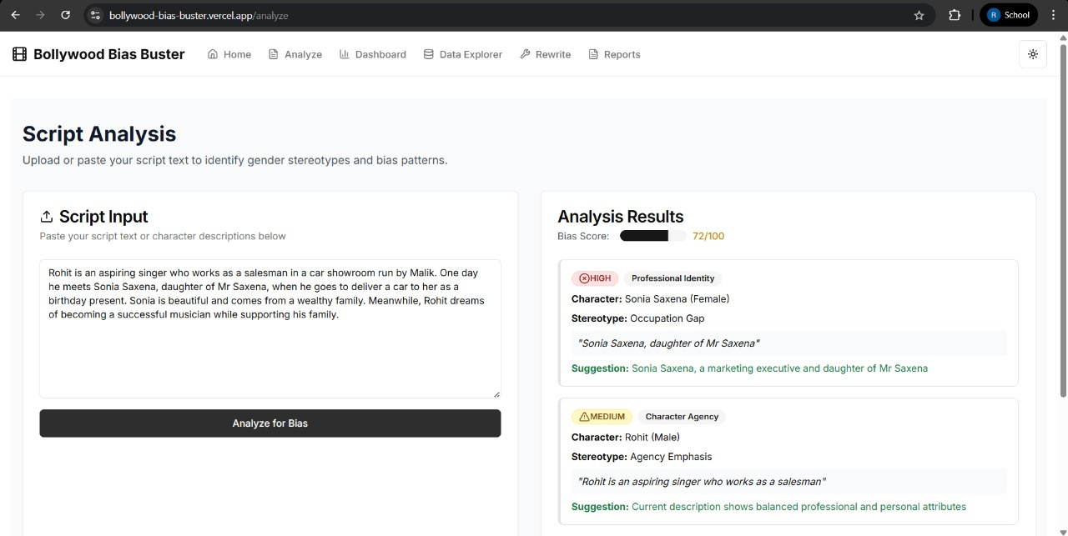

Project
Snap Shots
Python
CSS
Technology

Slide 10
CONCLUSION
Bollywood Bias Buster empowers creators with actionable insights
Tackles bias at script, poster, and genre levels
Aimed at building more inclusive and equitable narratives in Indian cinema

Slide 11

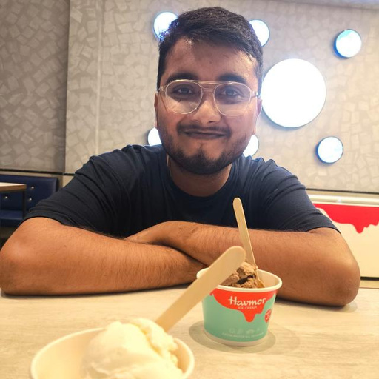




Contact
+91 9807486339
www.linkedin.com
i.rajverma8423@gmail.com
13, Patel Nagar ,Kanpur, Uttar Pradesh, India

